Slide 1
Java Project
CLOCK APPLICATION

Slide 2
What We Will be Including?
We have included 3 tabs inside tabbed pane.
They Consist:
Current Time
Stop Watch
World Clock

Slide 3
What are we using?
In this Project we will be using:
Abstract Window Toolkit(AWT) and Swing packages to build the GUI component and time library to get the current time and time of different zones.
We will also be using some of the Thread concept here.

Slide 4
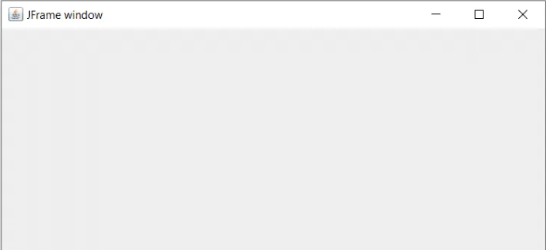
JFrame
This will be the main window we will be adding different components to.
Here we will be adding components like Tabbed Pane , Buttons , Label, etc.

Slide 5
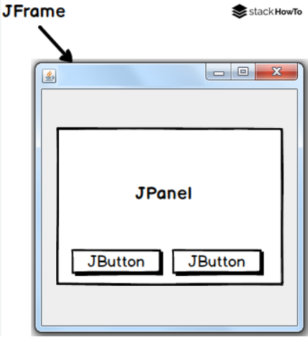
JPanel
We can say its similar to JFrame but it will exclude the top bar which shows us the minimizing, Close Option

Slide 6
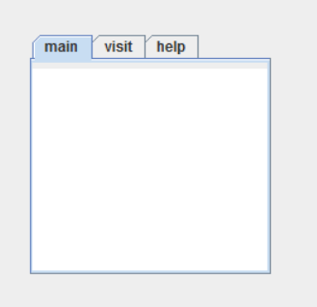
Tabbed Pane
You can just it as some tabs to allow us to switch between panels

Slide 7
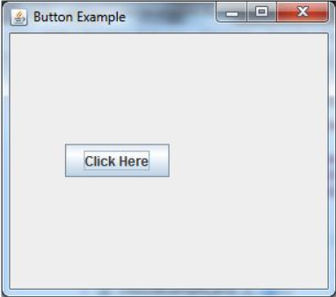
JButton
Well everyone knows what a button is, we press them and wait for the magic to happen.

Slide 8
Well in Last slide we tackled about some type of magic lets explore it a little bit more.
What happens is whenever we are performing any action such as clicking a button , Moving our mouse, pressing any key, etc. An event is triggered which are further classified into different categories like ActionEvent, KeyEvent, MouseEvent etc.
All we need to do is to define what happens when an event is triggered.
And there you have it over secret magic recipe.

Slide 9
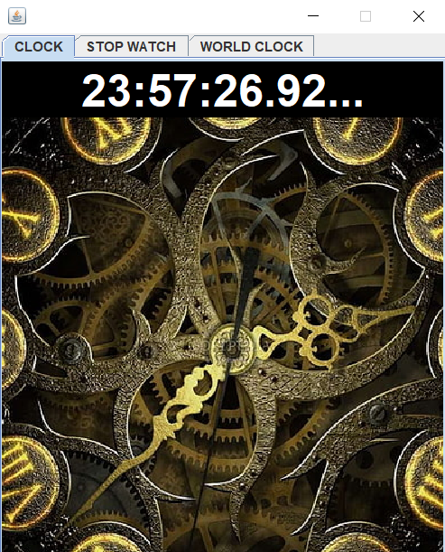
Lets see our first tab
In our first tab we have add a Panel.
In this panel on the top we have a Label which will tell us the current time. And under it we have a photo of a clock just to make it presentable and eye catching.
To change the time of our Label as the actual time changes we are using thread.

Slide 10
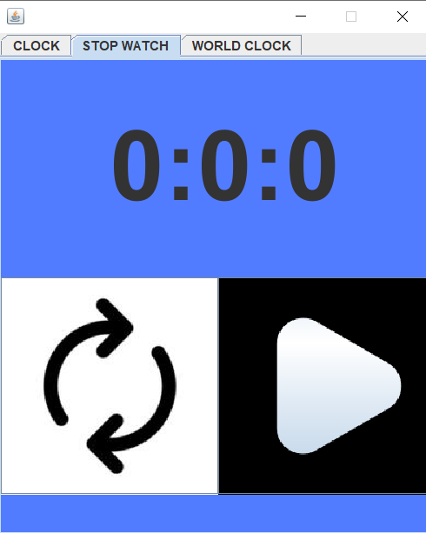
Lets see the Stop Watch
What you need to do is press on play button and Start the timer and with the same button you can pause the timer.
We have also provided you with a reset option.
To maintain the time difference between every second we are using there and changing our label inside it be applying sleep for 1000 milliseconds.

Slide 11
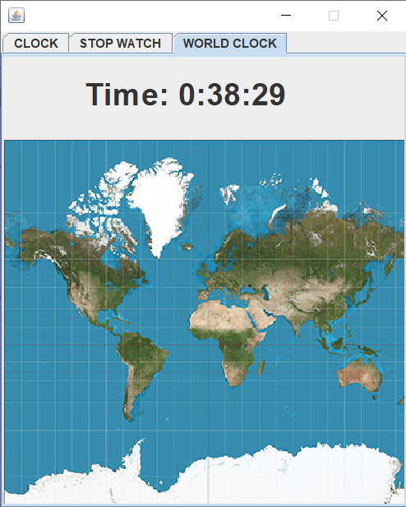
And at last we have the world clock
Here we have provided you with a world map which will show you the approx time where the cursor is placed.
To perform this function all we are doing is handling the mouse event.
Getting the pointer location in our panel and with the help of time library we are determining the time of that zone.

Slide 12
That’s All From Our Side
Thank You

